Slide 1
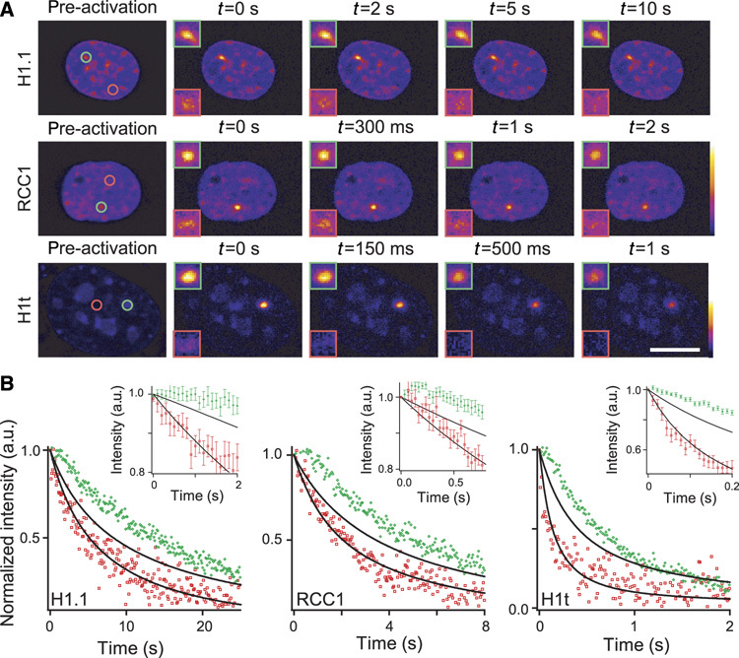
Molecular crowding affects diffusion and binding of nuclear proteins in heterochromatin and reveals the fractal organization of chromatin
The EMBO Journal, Volume: 28, Issue: 24, Pages: 3785-3798, First published: 19 November 2009, DOI: (10.1038/emboj.2009.340)
Notes:
Figure 3Binding of chromatin‐interacting proteins is enhanced in heterochromatin. (A) Pseudocoloured images of NIH3T3 cells transiently expressing H1.1–mPAGFP, RCC1–mPAGFP and H1t–PAGFP. Images are selected frames of PA time lapse with the photoactivated region represented by circles in euchromatin (red) or in heterochromatin (green) on the pre‐activation image. The inserts outlined in red and green correspond to two higher magnifications of photoactivated areas in euchromatin and heterochromatin, respectively. Two lookup tables associated to heterochromatin PA and nuclei, or to euchromatin PA are defined in the middle and lower panel, respectively. Experiments with RCC1–mPAGFP and H1t–mPAGFP were carried out at 26°C. Confocal section thickness values were set to 1.0 μm, that is, three times less than the photoactivated spot size. Scale bar 10 μm. (B) Graphs representing normalized intensities measured during relaxation in the circled regions of the experiment displayed in (A) (red: euchromatin, green: heterochromatin). Euchromatin responses are accurately fitted with a diffusion limited model (see Materials and methods section, lower solid line), but this model fails to reproduce heterochromatin response curves (upper solid lines) especially at short time scales, showing that chromatin protein dynamics are associated with a longer residence in heterochromatin right after PA. Insets represent average early time points responses measured in euchromatin and heterochromatin (red and green data sets, respectively) to emphasize on the initial plateau in heterochromatin.

